Slide 1
Introduction
Physical Layer is the bottom-most layer in the Open System Interconnection (OSI) Model which is a physical and electrical representation of the system.
It consists of various network components such as power plugs, connectors, receivers, cable types, etc. Physical Layer sends data bits from one device(s) (like a computer) to another device(s).
Physical Layer defines the types of encoding (that is how the 0’s and 1’s are encoded in a signal). Physical Layer is responsible for the communication of the unstructured raw data streams over a physical medium.

Slide 2
Module-2 Physical Layer
Dr. R. Prashanth

Slide 3
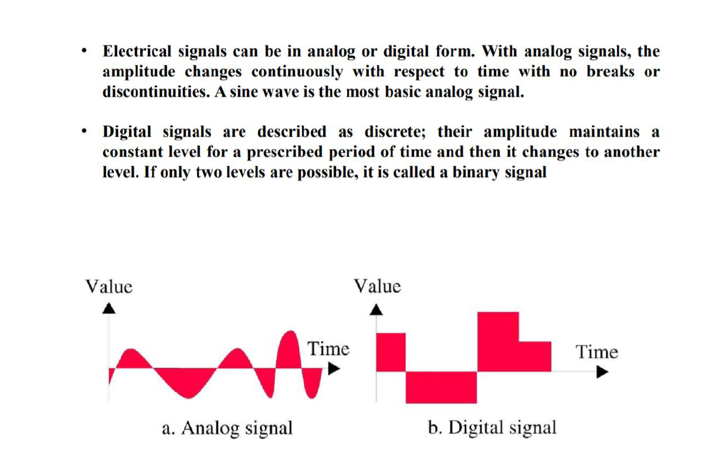
Analog and Digital Transmission

Slide 4
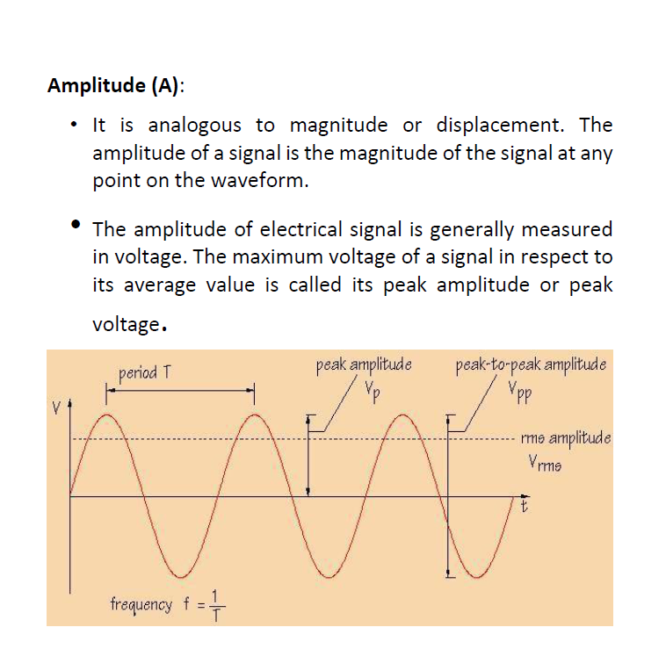

Slide 5
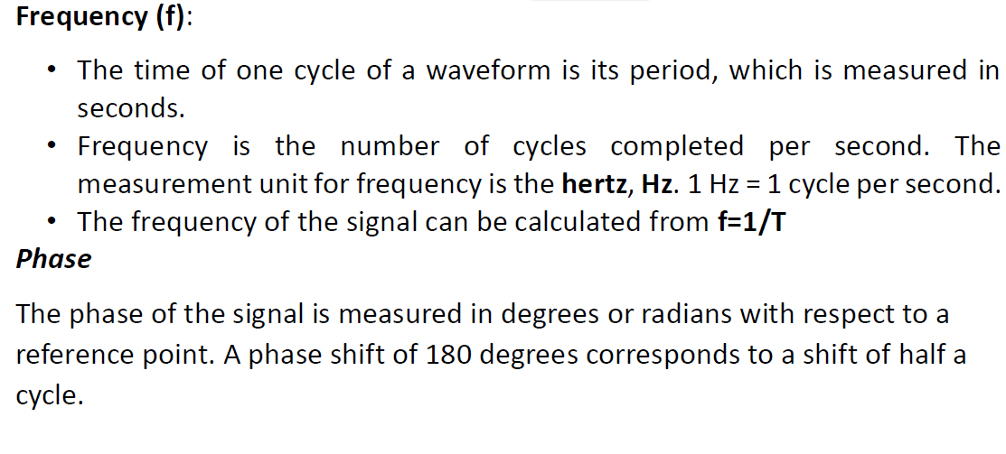

Slide 6
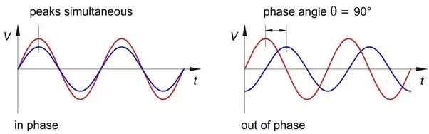

Slide 7
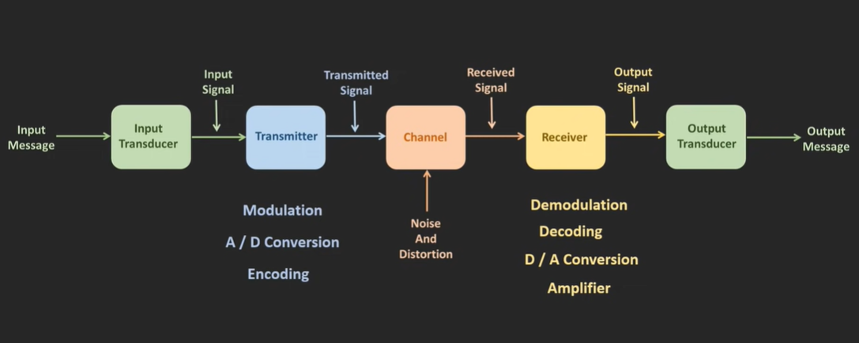

Slide 8
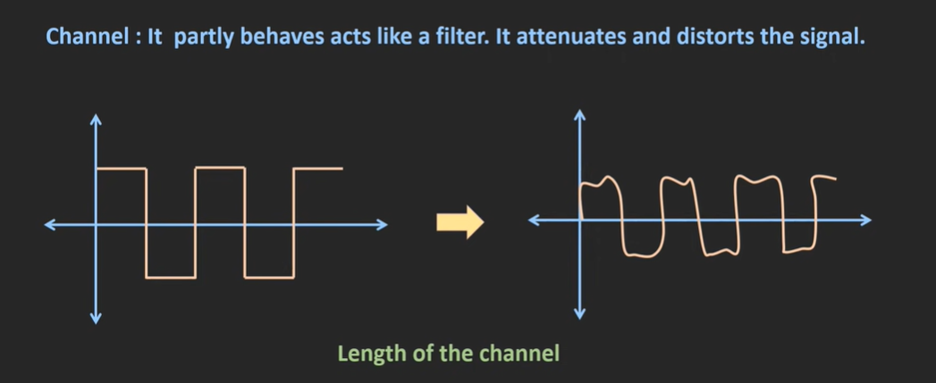

Slide 9
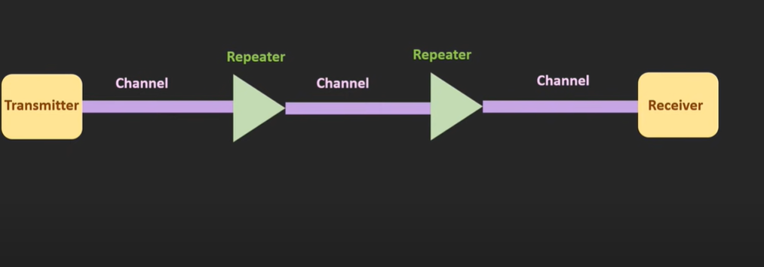

Slide 10
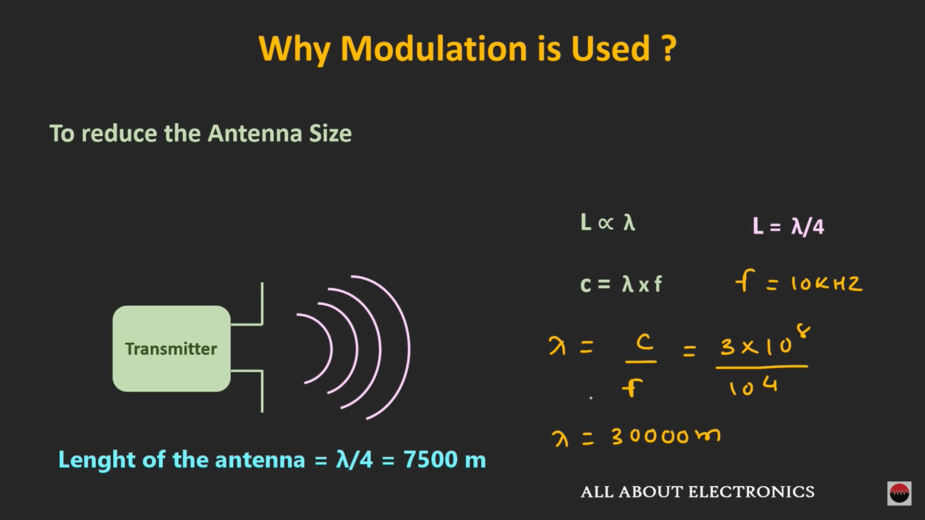

Slide 11
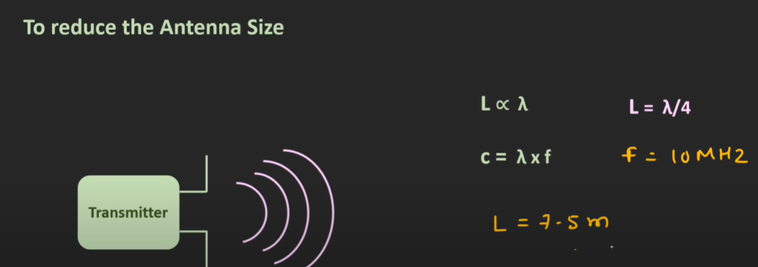

Slide 12
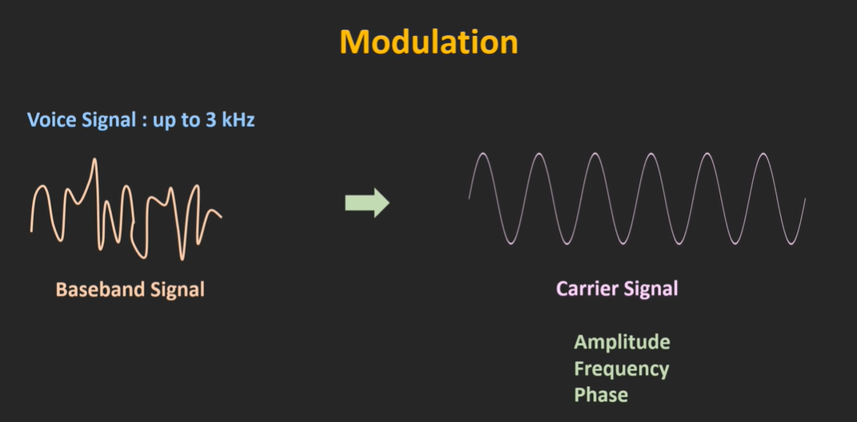

Slide 13
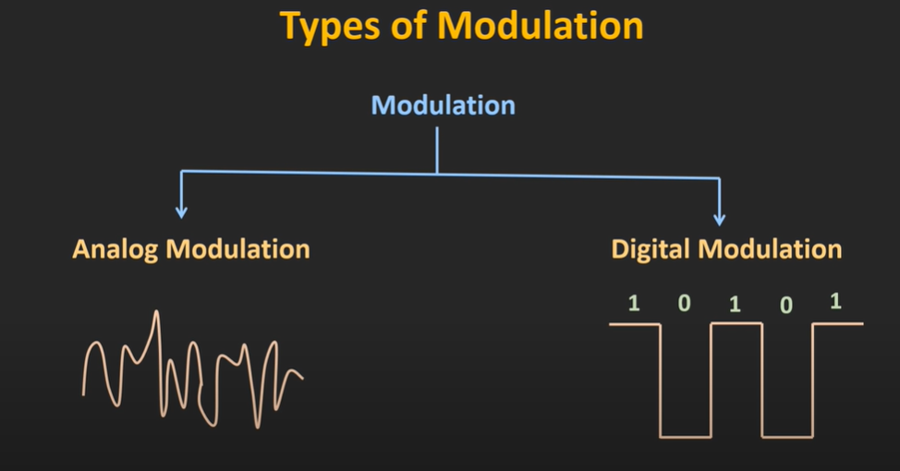

Slide 14
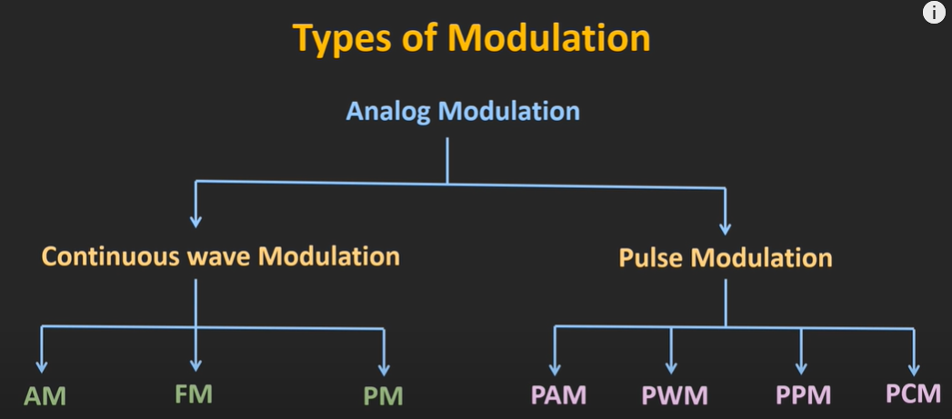

Slide 15
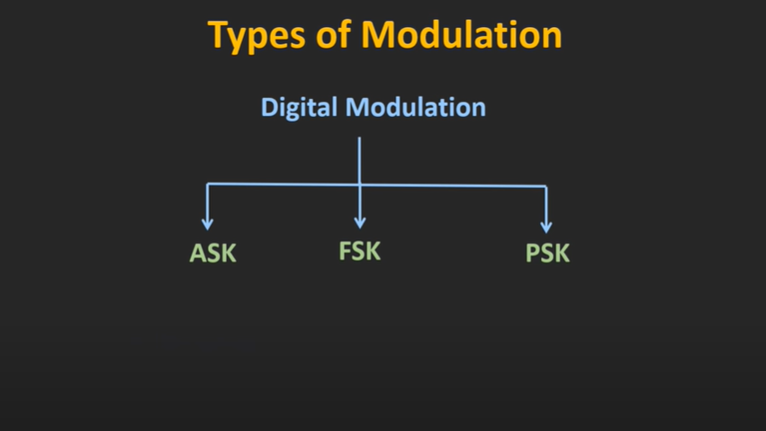

Slide 16
Encoding and Decoding
Encoding is the process of converting the data or a given sequence of characters, symbols, alphabets etc., into a specified format, for the secured transmission of data.
Decoding is the reverse process of encoding which is to extract the information from the converted format.
Encoding is the process of using various patterns of voltage or current levels to represent 1s and 0s of the digital signals on the transmission link.
The common types of line encoding are Unipolar, Polar, Bipolar, and Manchester.

Slide 17
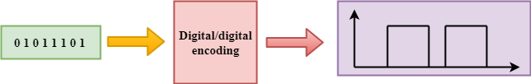
DIGITAL-TO-DIGITAL CONVERSION
Digital-to-digital encoding is the representation of digital information by a digital signal.
When binary 1s and 0s generated by the computer are translated into a sequence of voltage pulses that can be propagated over a wire, this process is known as digital-to-digital encoding.

Slide 18
Unipolar Encoding
Digital transmission system manages by sending voltage pulses and a medium link, usually a wire or cable. The most encoding one voltage stands for binary '0' and other voltage as binary '1'.
The polarity of pulse defines either +ve or – ve unipolar encoding because it works with only one polarity. This polarity is authorized to one of the two binary states, generally '1'. The other state frequently '0' described by zero voltage.
The figure explains the idea of unipolar encoding. The binary '1's treated as the +ve voltage and '0' are encoded as zero voltage. Unipolar encoding is simple and inexpensive.

Slide 19
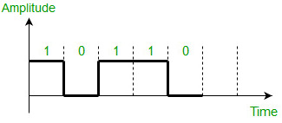
Unipolar encoding is a line code. A positive voltage represents a binary 1, and zero volts indicates a binary 0.

Slide 20
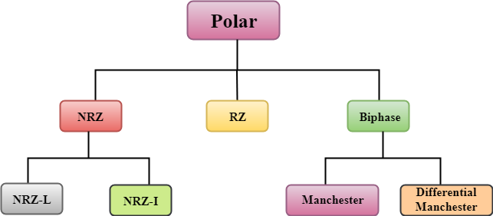
Polar Encoding
Polar encoding is an encoding design that needs two voltage methods — one is positive, and the second is negative. By using two voltage levels, an average voltage level is reduced, and the DC component problem of unipolar encoding scheme is alleviated.
Types of Polar Encoding

Slide 21
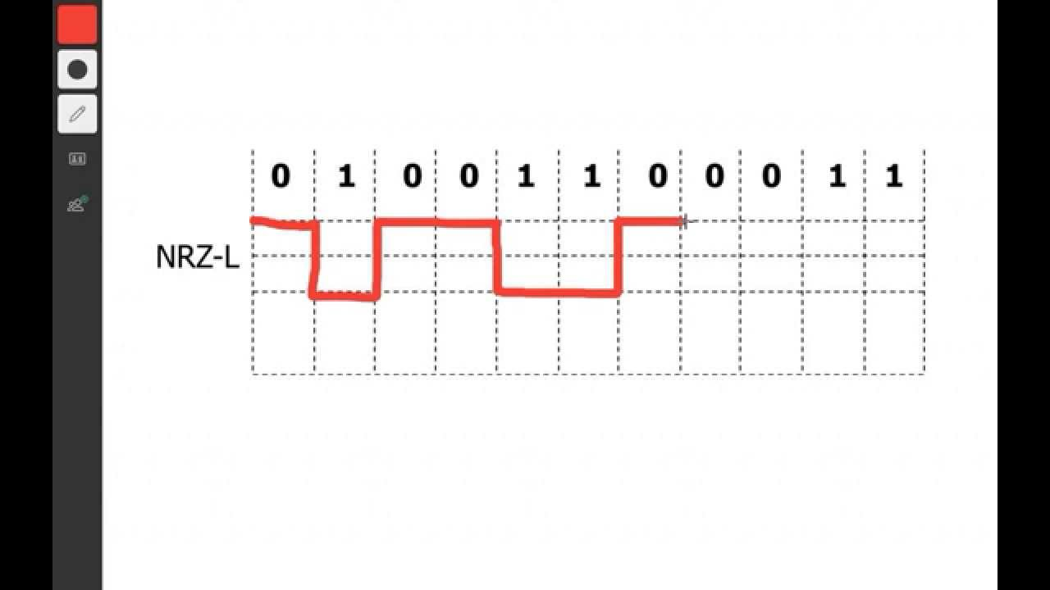
Non Return to Zero (NRZ)
There are two variations in NRZ namely − NRZ-L and NRZ-I
NRZ - L (NRZ – Level)
There is a change in the polarity of the signal, only when the incoming signal changes from 1 to 0 or from 0 to 1.

Slide 22
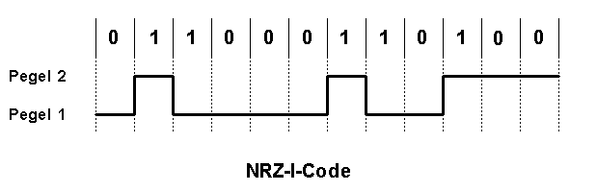
NRZ – I (NRZ – Inverted)
If a 1 occurs at the incoming signal, then there occurs a transition at the beginning of the bit interval. For a 0 at the incoming signal, there is no transition at the beginning of the bit interval.

Slide 23
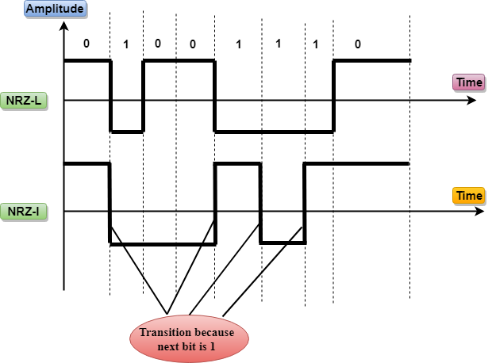
For more explanation: https://www.youtube.com/watch?v=10q6nhF4k0k

Slide 24
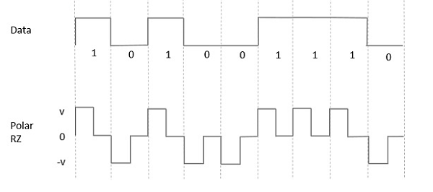
Polar RZ (Return to zero)
Half of the bit duration remains high but it immediately returns to zero and shows the absence of pulse during the remaining half of the bit duration.

Slide 25
Bi-phase Encoding
Biphase is an encoding scheme in which signal changes at the middle of the bit interval but does not return to zero. There are two types of Bi-phase Encoding.
Bi-phase Manchester
Differential Manchester

Slide 26
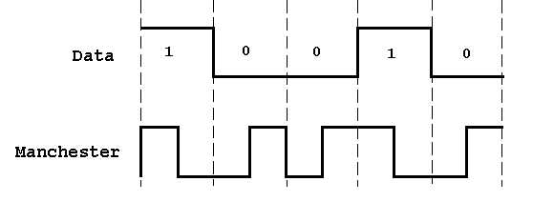
Bi-phase Manchester
In this type of encoding, the transition is done at the middle of the bit-interval. The transition for the resultant pulse is from High to Low in the middle of the interval, for the input bit 1. While the transition is from Low to High for the input bit 0.

Slide 27
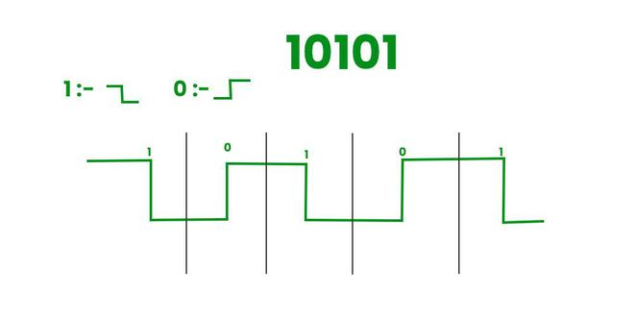

Slide 28
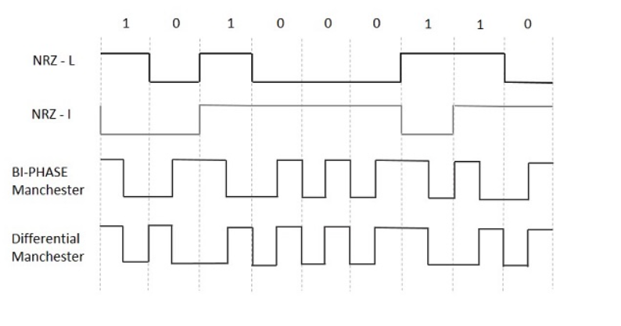
Differential Manchester
If there occurs a transition at the beginning of the bit interval, then the input bit is 1. If no transition occurs at the beginning of the bit interval, then the input bit is 0.

Slide 30
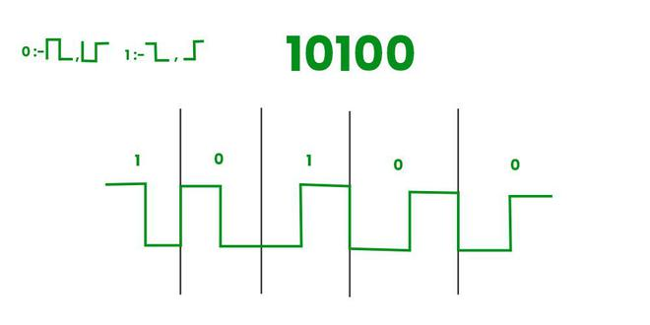
In Differential Manchester Encoding 0 should contain an edge but 1 should not contain any edge it should be continuous.
For more explanation: https://www.youtube.com/watch?v=3IaB2a8tXLA

Slide 31
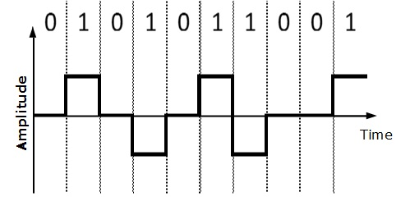
Bipolar
This is an encoding technique which has three voltage levels namely +, - and 0. For a 1, the voltage level gets a transition from + to – or from – to +, having alternate 1s to be of equal polarity. A 0 will have a zero voltage level.
For more info: https://www.youtube.com/watch?v=pmHiGI7w1Kk

